Slide 1



Welcome to our
Annual General Meeting

Slide 2





Welcome
The meeting will begin shortly
Please use the chat function to introduce yourself and say hello to others and to ask any questions during the meeting.
During the meeting, please mute your mic. If you would like to use subtitles, please activate the ‘closed captions’.
Please use the ‘raise your hand’ button if you wish to speak.
We will be recording the session. If you have any concerns about this, please let us know.

Slide 3
Agenda
5pm | Welcome and opening remarks from Graham Russell, Trust Chair
5.10pm | Overview of our Year from Douglas Blair, Chief Executive
5.30pm | Finance Report from Sandra Betney, Director of Finance and Deputy Chief Executive
5.45pm | Quality Update from Nicola Hazle, Director of Nursing, Therapies and Quality
6.05pm | Council of Governors Update from Chris Witham, Lead Governor
6.15pm | Final questions and closing remarks from Graham Russell
6.30pm | Ends

Slide 4
Opening Remarks
Graham Russell
Trust Chair

Slide 5
Review of the Year
Douglas Blair
Chief Executive

Slide 6
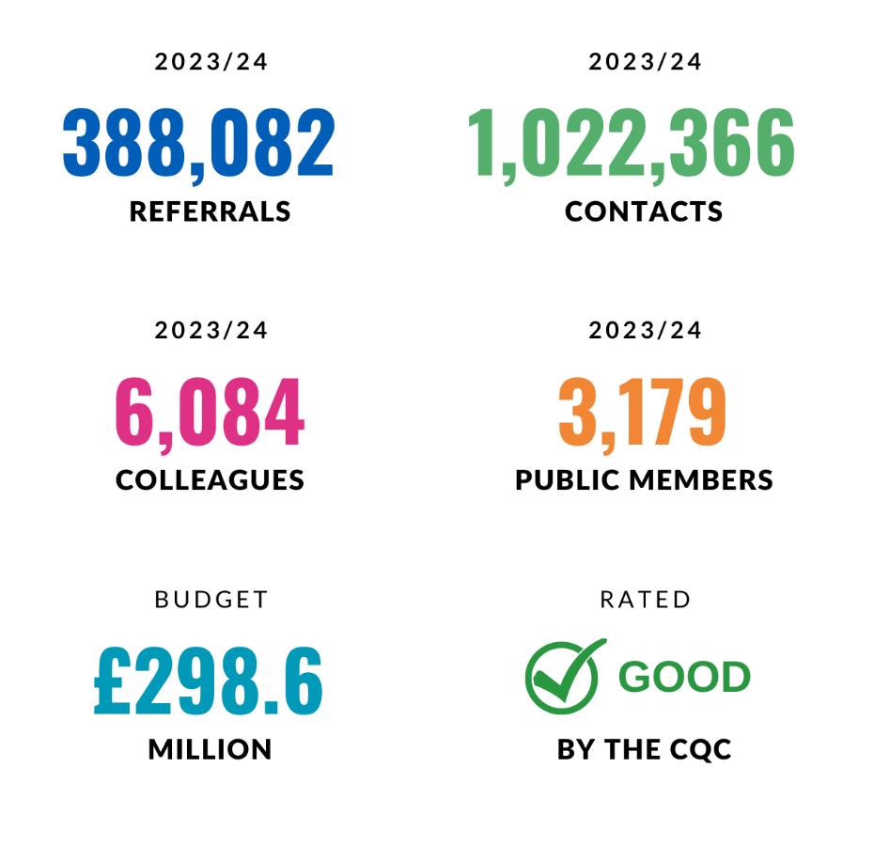
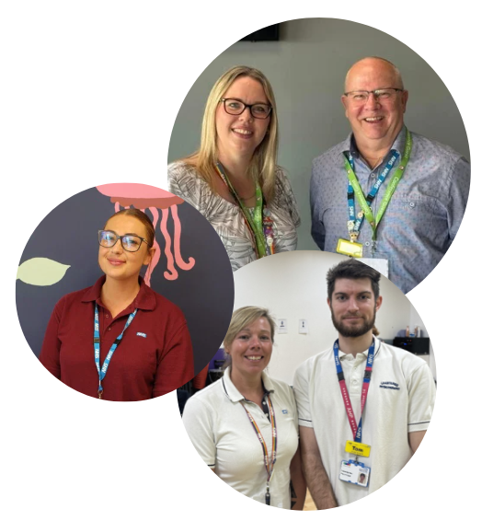


Slide 7
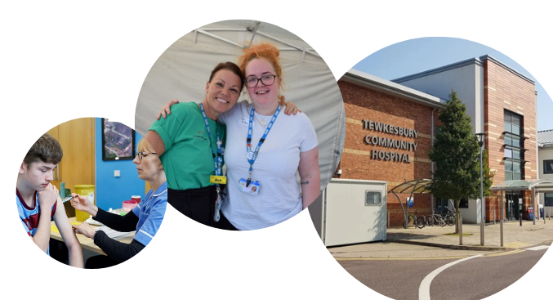
We have more than 100 services, including:
Mental Health and Learning Disability Urgent Care and Inpatient services
Physical Health Urgent Care and Inpatient services
Community Physical Health, Mental Health, and Learning Disability Services
Children and Young People’s Services
Countywide Services

Slide 8
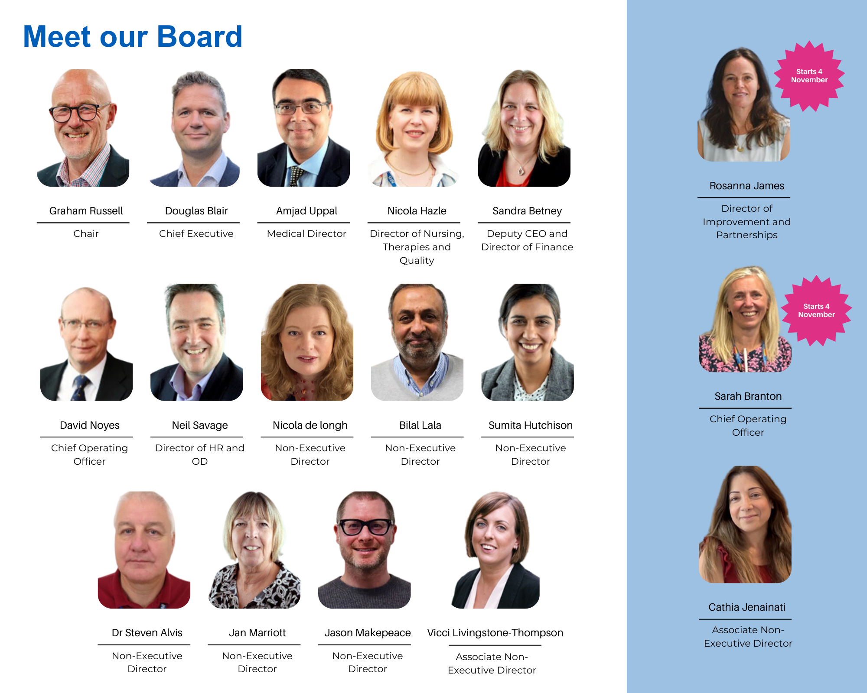

Slide 9
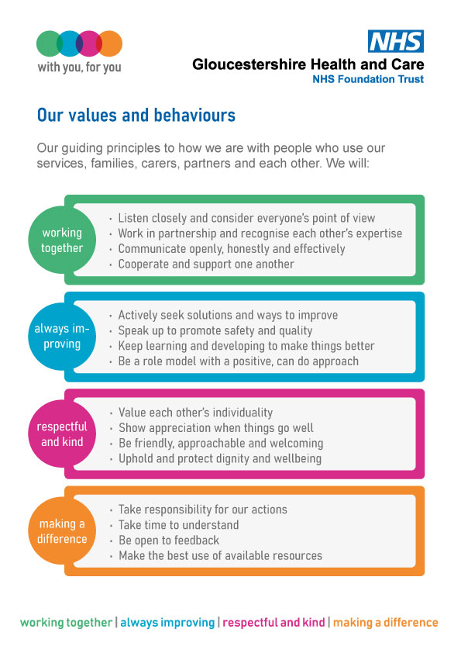
Our Trust Values

Slide 10



Trust Strategy
Our five-year strategy for 2021 to 2026 is
“Better Care Together - With You, For You”.
We have four strategic aims:
High Quality Care
Better Health
Great Place to Work
Sustainability

Slide 11
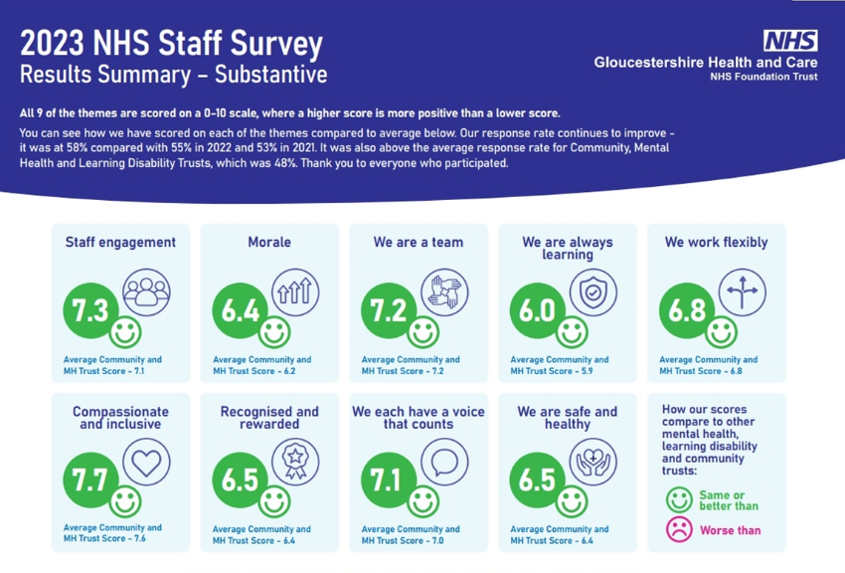

Slide 12
Staff Survey Highlights
Response rate = 58.5% (55% the previous year)
Improved ratings across all seven People Promise areas
Compared to 2022, approximately 60% of questions recorded improved ratings, 39% worsened and 1% remained the same
Fewer colleagues looking for new jobs/thinking of leaving
Improvements in Friends and Family test ratings – now 10% above comparator Trusts
Nearly three quarters of the workforce recommend the Trust as a place to work
Our results put us in the top Trusts nationally and best in the south west (joint with Dorset)! BUT still more to do and improve…

Slide 13
Staff Survey Areas of Focus
Health and Wellbeing: There have been a number of new / different questions however nearly two thirds of the scores are lower than 2022.
Internationally educated nurses: Working with our staff survey provider to pull data that will allow us to better understand any similarities/differences within our IEN workforce. This is particularly in order to help support Recruitment and retention.
Harassment and violence at work: Results illustrate an increase in the number of incidents staff are subjected to from patients & families and staff. We also see that Bank colleagues score higher in comparison to substantive with regard to experiencing harassment.
Flexible working: We will be looking to find out what we could do to get from average to top quartile in our working flexible scores.

Slide 14
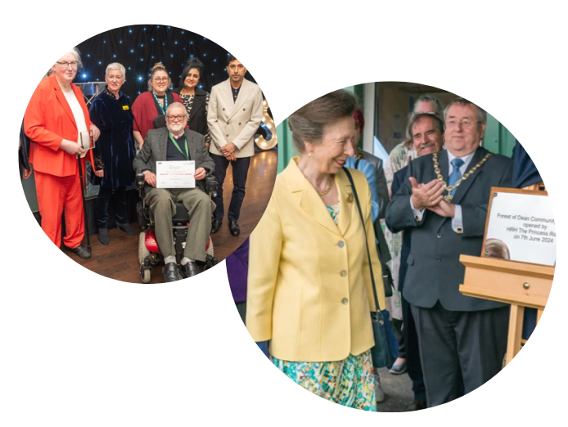
Reasons to Celebrate (last 12 months)
Official opening of Forest of Dean Community Hospital
National Preceptorship Interim Quality Mark
NHS Pastoral Care Quality Award
Our direct carbon footprint is down by 14%
Large Employer of the Year in annual south west Apprenticeship Awards
Gold Award in Employer Recognition Scheme for support to veterans

Slide 15
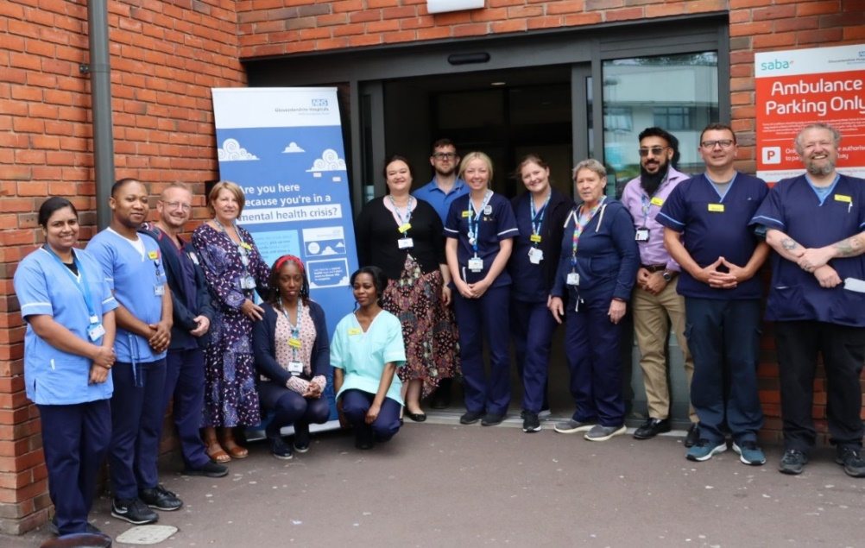
Looking forward
Launch of the new Integrated Urgent Care service
More work with partners to address pressures in urgent and emergency care
Tackling health inequalities remains a priority
Reduce waiting times for some services
Continuing to work on transforming community mental health services and learning disability services
Responding to increased policy focus of shift from hospital to community settings

Slide 16
Financial Performance and Accounts
12 Months to 31st March 2024
Sandra Betney
Director of Finance

Slide 17
Our Income
83% of our total income of £302m is from Integrated Care Boards

Slide 18
Our Expenditure
Almost three quarters of our total expenditure of £301.5m relates to staffing costs, this includes wages and pensions and National Insurance contributions

Slide 19
Expenditure by Directorate

Slide 20
Overview of Financial performance
In the 2023/24 financial year, we have:
  Met our Financial Performance target of break even
  Reported a surplus of £984k
  Delivered £15.1m of Capital Projects
  Achieved £5.03m of recurrent savings
  Ended the year with a cash balance of £51.4m

Slide 21
Financial Review

Slide 22
Our 2023-24 Financial Position

Slide 23
Capital 2023/24
The Trust uses the surplus it generates to help fund the capital programme and improve the facilities for our service users and staff. The Trust spent £15.1m on capital.

Slide 24

Forest of Dean Hospital

Slide 25
Forest of Dean Hospital
In March 2022 the Trust was granted planning permission for a new community hospital for the Forest of Dean to replace Dilke Memorial Hospital and Lydney Community Hospital.
On the 7th June 2024 the new Forest of Dean Community Hospital was officially opened
The final capital expenditure total for the new hospital is £27.4m

Slide 26
Audit of Accounts
Accounts audited by KPMG in June 2024
They issued an:
    Unmodified Audit Opinion
    Unqualified Value for Money Opinion
Our latest Annual Report and Accounts can be found on our website: www.ghc.nhs.uk/who-we-are/publications
Any queries to Sandra.Betney@ghc.nhs.uk or Stephen.Andrews@ghc.nhs.uk

Slide 27
Quality Presentation
Nicola Hazle
Director of Nursing, Therapies, and Quality

Slide 28
Purpose of the session - What information is being presented today and why
We wish give an overview of the work undertaken across the Trust highlighting changes and improvements that have taken place which are informed by our Quality Strategy and reflect our Trust values.
We are providing information and detail in relation to our quality priorities which are underpinned by our quality ambitions.
We have assurance that our services are in the main good, with some areas of focus.
28

Slide 29
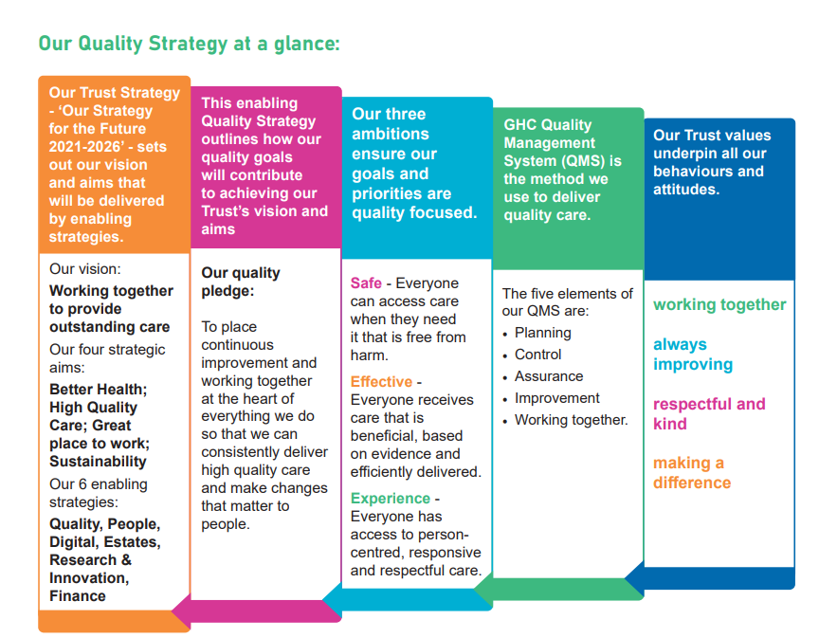
Quality Strategy
Notes:
The Quality Priorities originate from the Quality Strategy
- Our Quality Strategy sets out our quality ambitions, strategic goals, priorities, and the approaches we will take to measure our progress. It is one of six integrated enabling strategies delivering Gloucestershire Health and Care NHS Foundation Trust’s (GHC) strategy: ‘Our Strategy for the Future 2021-2026’.
- Through our Quality Strategy, we are making clear our commitment and approach to empower the people at the heart of our services. Our colleagues have the freedom, skills, tools and resources to work in partnership with the people we serve to improve and innovate safely towards defined quality goals.

Slide 30
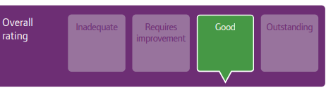
CQC Information from 2022 inspection
Notes:
Care Quality Commission is the regulator and inspector for health and social care providers in England.
Following our most recent Trust inspection we received an overall rating of Good
It is important to recognise that underneath the overall rating there are service specific ratings. Our physical health inpatient and community services hold ratings of good, with a few rated outstanding. This is largely reflective in our community mental health services from their last inspection in 2016. Our mental health inpatient services have ratings of requires improvement and our learning disability inpatient service which is Berkeley House has a rating of inadequate

Slide 31
Quality Priorities for 2023/25
Our 11 Quality Priorities which are a key area of focus are:
  Tissue Viability (TV) including pressure ulcers
  Dementia Education
  Falls prevention
  End of Life Care (EoLC)
  Friends and Family Test (FFT)
  Reducing suicides
  Reducing Restrictive Practice
  Learning disabilities
  Children’s services
  Embedding learning following patient safety incidents
  Carers
Notes:
To delivery our Quality Strategy we have identified a number of quality priority which we are working to achieve over two years from 2023 to 2025
These were developed from a range of stakeholder events by our Strategy and Partnership Team including those with lived experience.
Many of these priorities are linked to the areas of improvement identified by CQC inspections, others respond to areas of clinical improvement that we have identified through our own governance assurance as well as other regional and national opportunities.

Slide 32
Three Pillars of Quality
Our quality ambitions are always underpinned by the three pillars of quality:
Always effective – embedding a culture of continuous improvement in all of our services.
Great experience – making sure everyone’s experience is personalised and is consistently the best it can be.
Consistently safe – people who use and deliver our services consistently receive intervention free from harm and which provides the most benefit.
Notes:
The quality ambition that we hold within our Quality Strategy, as set out in the earlier slides are underpinned by the three pillars of quality, which are
Set out examples against each pillar, these are broad and we will triangulate the data across these different sources to support our overall position of assurance

Slide 33
Always Effective
We have good assurance that we are embedding a culture of continuous improvement in all our services.
We completed 6 national clinical audits and 72 local clinical audits relating to mental health and physical health services.
Improved awareness, monitoring and learning across our community nursing services has supported improved early intervention and management of pressure ulcers.
A new Research and Innovation Strategy was agreed by the Trust, with a key focus on collaboration.
In our commitment to Quality Improvement (QI) we currently have 61 projects running and an ambition to increase each year.
Notes:
All audits included recommendations to share improvement and best practice across the organisation. Some themes have featured highly and align to ongoing work such as falls prevention, dementia education, and length of stay.
R&I – we will be working closely with Research 4 Gloucestershire partners during this year to set up systems to support a truly collaborative, system wide approach to research, development and innovation.
Virtual wards span 5 specialities
QI survey – of 211 people, 82% had heard of QI, 65% said QI was a standing agenda item on team meetings, 66% rated themselves as having at least some awareness of QI, 50% state they had been involved in a QI project (as a team, in the trust, as a lead)

Slide 34
Great Experience
We have good assurance that we strive to ensure that everyone's experience is personalised and consistently the best it can be.
Our successful implementation of the NHS Friends and Family Test (FFT) saw an uplift of 51% in responses with consistency in 94% reporting an overall positive experience.
Non-Executive Director (NED) quality visits and complaint audits provide valuable feedback and assurance across a range of services.
We hold level 1 and level 2 Triangle of Care accreditation with The Carers Trust who are in support of our work towards level 3.
Our embedded Freedom to Speak Up process saw 96 colleagues using the service last year and 100 Champions now trained. 42% of the contacts received related to health and wellbeing.
Notes:
FFT – uplift in responses is 20256 to 30519. In 2023/24 we received 150 formal complaints and 218 formal concerns – an alteration on the previous year from 136 formal complaints and 689 concerns.
As in previous years the number of compliments received far outweighed complaints and concerns and we received 2506 compliments in total.
The new Patient and Carer Experience Team (PCET) process launched on 1st August and is in line with the revised NHS Complaints Standard that ensure the correct structures and systems are in place to capture and act on feedback, provide timely resolutions and deliver better patient and carer (and staff) experience.
Triangle of Care is a national accreditation that recognises the alliance between carers, service users and health professionals which promotes safety and recovery.
FTSU – we recognise there is still work to do with 14% staff who spoke up felt that they have been adversely affected as a result.

Slide 35
Consistently Safe
We have good assurance that people who use and deliver our services consistently receive intervention that is free from harm and provides the most benefit.
Implementation of the Patient Safety Incident Response Framework (PSIRF) has seen new learning responses to patient safety incidents used which have been met with positivity.
We have improved our safeguarding process to better flow data in the Trust and with the local authority. Our dedicated safeguarding advice line provides specialist support to clinicians across adult and children’s services.
During 2023/24 we improved our recording of clinical supervision with work ongoing to assure the quality of supervision.
The annual Learning From Deaths report found that no deaths were due to problems with care delivery. Feedback from the Medical Examiner provides significant assurance that that the care provided to GHC inpatients at the time of their death was of an excellent standard.
Notes:
PSIRF four aims. New learning responses such as After Action Reviews – positivity and contributing to a culture of learning
Anonymous feedback quote “the meeting was very helpful and brough together multiple teams that were involved in the persons care. We identified learning areas collaboratively.”
Serious incidents 2023/24 – MH 22 down from 31 previous year, and PH 0 down from 8 in previous year
Any relevant details for safeguarding processes?
Supervision is a fundamental clinical practices for all staff in clinical services to delivering safe, effective care.
The CQC closed culture-related work applies to services that can be described as locked environments or areas where open access is restricted. Alongside these areas, services that deliver care to people that have communication or significant cognitive challenges are also considered at risk of becoming a closed culture. We have identified the settings in the Trust as potentially having a raised risk of a closed culture. Which are the focus of increased monitoring and support to eliminate this risk.
Feedback from ME around excellent standard shows that families were appreciative of the Medical Examiner input and were satisfied with the cause of death given and gladly gave feedback about care when asked.

Slide 36

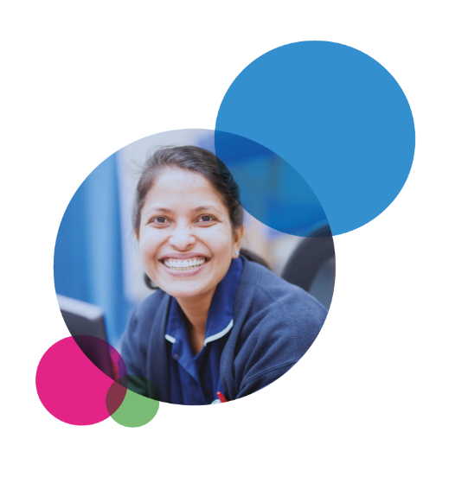
Council of Governors Update
Chris Witham
Lead Governor
September 2024

Slide 37
Introduction
Foundation Trusts have a membership body – comprising public and staff members. The membership elects people to represent them on the Council of Governors.

Slide 38
The Role of the Governors
To hold the Non-Executive Directors to account for the performance of the Board;
To represent the interests of the Trust’s stakeholders in the governance of the organisation; and
To communicate the key messages of the Trust to the electorate and appointing bodies.

Slide 39
Who are the Governors?
The Council of Governors is currently made up of:
13 Public Governors in 7 constituencies
7 Staff Governors in 3 classes
4 Appointed Governors*
- Gloucestershire County Council
- Young Gloucestershire
- Healthwatch Gloucestershire
- Inclusion Gloucestershire
Trust Chair
* The Trust may choose to have up to 5 appointed Governors on the Council

Slide 40
Membership
At the end of 2023/24, the Trust had a total membership of 8,145:
3179 public members (breakdown below)
4966 staff members
Cheltenham 516
Cotswolds 237
Forest of Dean 303
Gloucester 709
Stroud 516
Tewkesbury 346
Greater England and Wales 552

Slide 41
In 2023/24……
There were 6 formal Council meetings
Two Governor Development sessions took place. The session in July 2023 was used as an opportunity for the Council to carry out a review of its own effectiveness. The second session in January 2024 and was a joint Governor / Non-Executive Director session focussing on Trust Strategy development and Business Planning
Governors continued to receive the monthly schedule of Trust engagement events, inviting Governors to join colleagues at events around the county to promote membership
Governors participated in national Governor forums, conferences and workshops run by NHS Providers
Governors have had the opportunity to carry out visits to sites and services, with recent visits to the new hospital in the Forest of Dean

Slide 42
In 2023/24……
The Council of Governors:
Received the Governor Dashboard which provides a high-level overview of performance and quality measures,
Reviewed the NHS Staff Survey results and action plan,
Received and commented on the Trust’s Quality Account,
Received a number of service focussed presentations providing information on the Trust’s clinical systems, our Eating Disorder services, a community hospital overview and a presentation on the Falls Reduction work taking place across the Trust.
Approved a recommendation for the extension of the external auditor

Slide 43
In 2023/24……
Following a robust process overseen by the Governors’ Nominations and Remuneration Committee, the Council approved the appointment of a new Trust Chair, who commenced in post on 1 May 2024.
The Council have also received and endorsed recommendations around the recruitment process for Non-Executive Directors and approved the extension to the term of an existing NED.

Slide 44
The year ahead
We will continue to seek assurances around Trust performance and delivery
We will continue to enhance our membership strategy and engagement opportunities
We will build on work carried out to strengthen our Council and our ways of working
Continue to promote Governor attendance at local and national events

Slide 45

Questions and closing remarks
Graham Russell, Chair

